Slide 1
E-Commerce
Marketplace Dashboard
By Matthew Grega and Drew Pickett

Slide 2
Project Overview
A database-backed dashboard for an online marketplace that helps analyze customer and product activity and provides insight that supports business decisions
Catalog — products organized into categories (Electronics, Apparel, Home & Kitchen, Books, etc.), each with pricing and descriptions
Stock — inventory levels tracked per product
Customers — both registered users (with accounts) and guest users (checkout without signing up)
Sales — transactions and the individual line items within each order
Feedback — product reviews and ratings from users

Slide 3
Analysis Phase
Identified the core entities : Category, Product, Inventory, User, Transaction, Review.
Defined attributes for each : Product has a name, price, description, and date added; a Transaction has a date and total price.
Worked out the relationships and business rules between them:
A product belongs to one category; a category has many products
A product has inventory tracking how much is in stock
A user can be either a registered account or a guest
etc.
Other Assumptions
Product's price is recorded at the time of purchase, so past orders keep their original price even if the product's price changes later.

Slide 4
Logical Model: Unnormalized
One Order Row Might Contain:
Customer name and details
Order date and total
Product 1 name, price, quantity
Product 2 name, price, quantity
Product 3 name, price, quantity etc.

Slide 5
Logical Model: Normalized
First Normal Form: eliminate repeating groups
Each row holds a single value per column.
Every line item becomes its own row in a separate TransactionItem table.
Second Normal Form: remove partial dependencies
Every non-key column depends on the whole key
Product details don't belong in the line-item table and move into their own Product table.
The line item keeps only what's specific to that purchase
Third Normal Form : remove transitive dependencies
No non-key column depends on another non-key column.
A product's category name shouldn't live on the Product table
Category becomes its own table referenced by ID.
Customer details likewise move out into the User table.

Slide 6
Logical Model: Normalized (Cont)
Boyce-Codd Normal Form: every determinant must be a candidate key
Any column that determines another column must itself be a key.
For example in Product, the only thing determining the other columns is the primary key
Fourth Normal Form: no multivalued dependencies
No table stores two independent one-to-many facts about the same entity.
Eg. transactions and their reviews into one table (two unrelated facts about users)

Slide 7
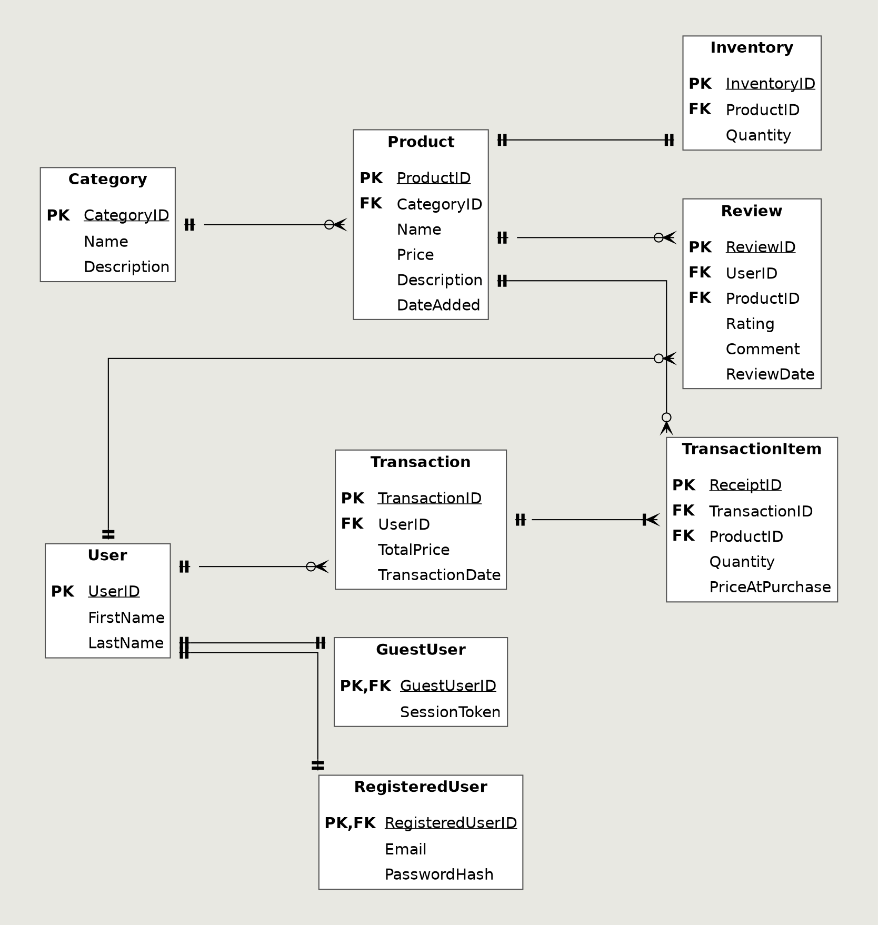
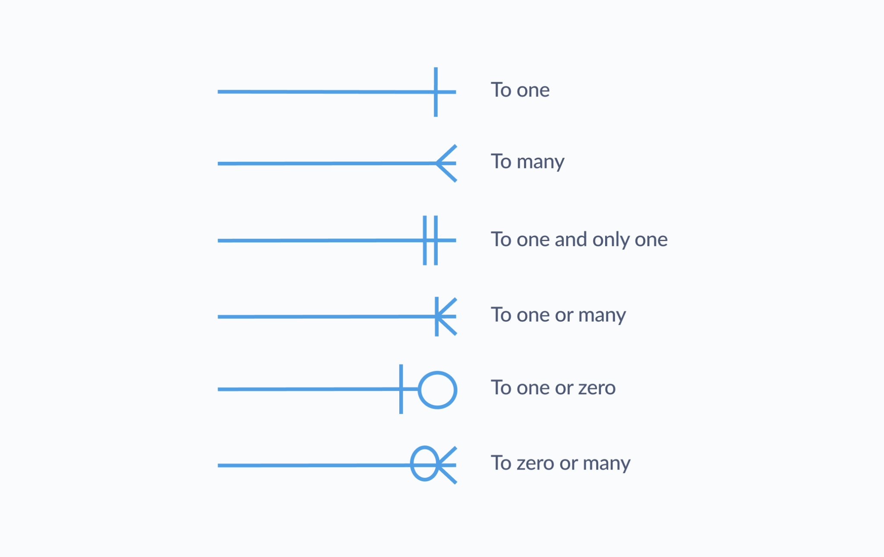
ERD
A product belongs to one category; a category has many products
A product has inventory tracking how much is in stock
A user can be either a registered account or a guest

Slide 8
ERD to Database
Tables built in dependency order
ERD PK’s were Auto Increment Primary Keys
Each crows foot is a Foreign Key
Implemented the User Supertype and Registered/Guest Subtypes
CASCADE
Inventory, User Subtypes, and Reviews are removed with parent.
RESTRICT
User/Product can’t be deleted while tied to a transaction
SET NULL
A product survives if category is deleted
Seeded with AI test data

Slide 9
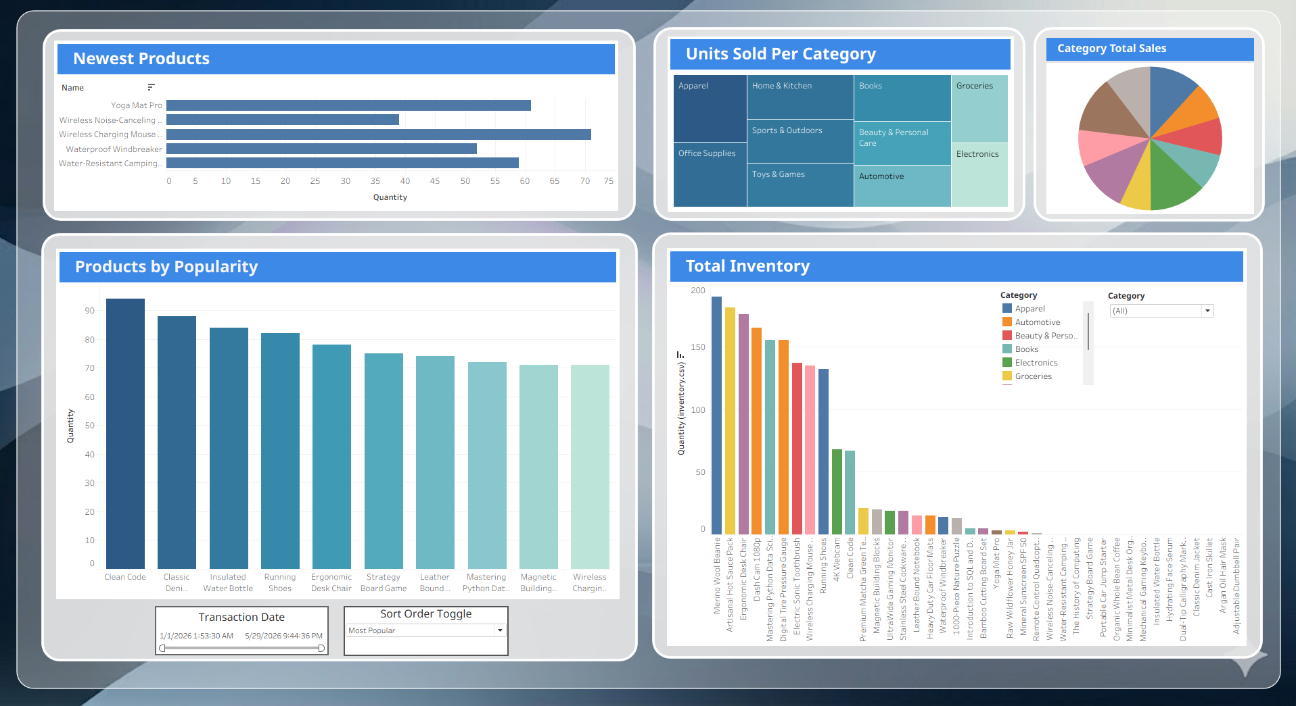
DashBoard Demo

